Slide 1


Dr. D. Y. Patil Pratishthan's Institute for Advanced Computing and Software Development Akurdi, Pune
Project Title :- Medical Store Management System
PG-DAC FEB-2020
Project Guide : - Mr. Chetan Pardeshi Submitted By :- Dipti Lalage
Mrunali Mangulkar

Slide 2
Introduction :
This project is used mainly for medical stores to maintain the details of medical store such as stock, medicines and staff information.
This medical shop management software is so designed as to ease the work load of medical shop professionals. The main feature includes add, update, delete medicines, staff and also control stock and give stock alert message.

Slide 3
Scope & Objectives :
As this is generic software it can be used by a wide variety of outlets (Retailers and Wholesalers) to automate the process of manually maintaining the records related to the subject of maintaining the stock.
This project is basically updating the manual medical inventory System To Automated inventory system, So that they can manage their record in efficient and organized form.

Slide 4
This software helps you to track all the products of medical shop moreover it’s a medical shop storing software.
Flexible and adaptive software suited to medical shops or stores or pharmacies of any size.
Project Characteristics:
Stock Management
Staff Management
Medicines Management
Stock Alert.

Slide 5
Project Features:-
Easy to Add ,Delete, Update medical shops, Staff and medicines.
System will notify about stocks of medicines
No need to check manually about medicines stock

Slide 6
Drawbacks :
Problem of maintaining records of daily medicines.
Problem to specific product.

Slide 7
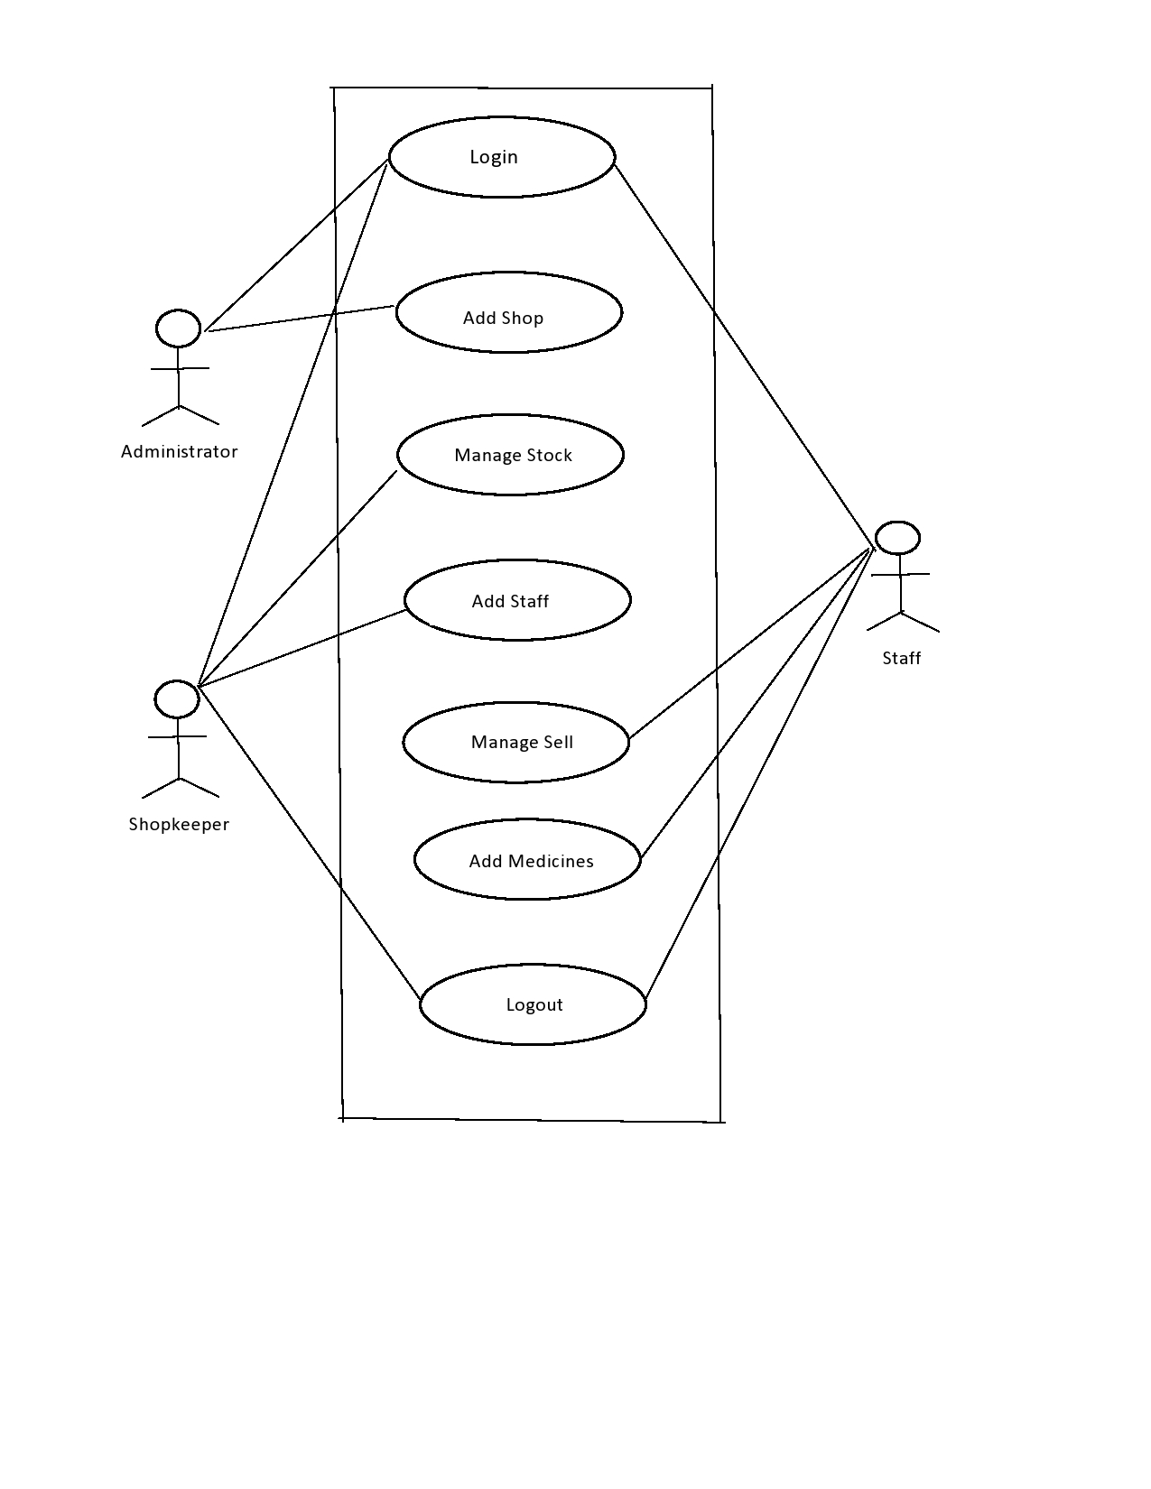
Use Case Diagram :-
Fig. Use Case Diagram

Slide 8
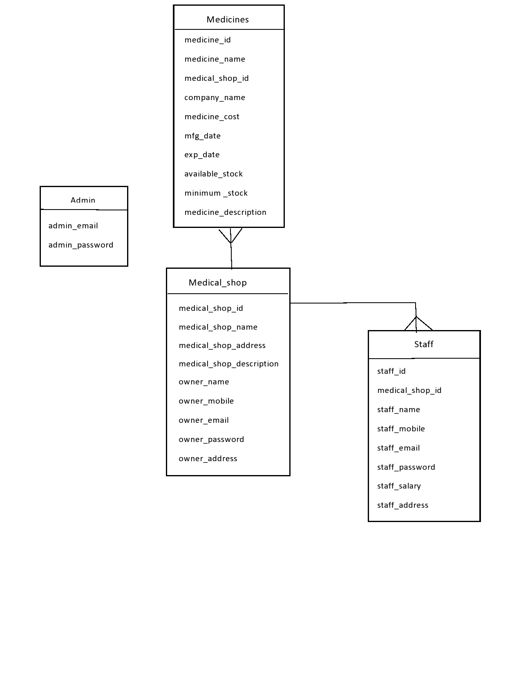
ER Diagram:-
Fig. ER Diagram

Slide 9
Future Scope :
This project is further enhanced by adding billing functionality.
Also enhanced by adding message and email alerts.

Slide 10
Conclusion :
Medical Store Management system allows user to perform stock management, medicines management, staff management. User get the information about stocks early. So user cannot face problem for handling stocks. So Medical Store Management software is very needy for Medical Store . This software help them to maintain daily records in computer.

Slide 11
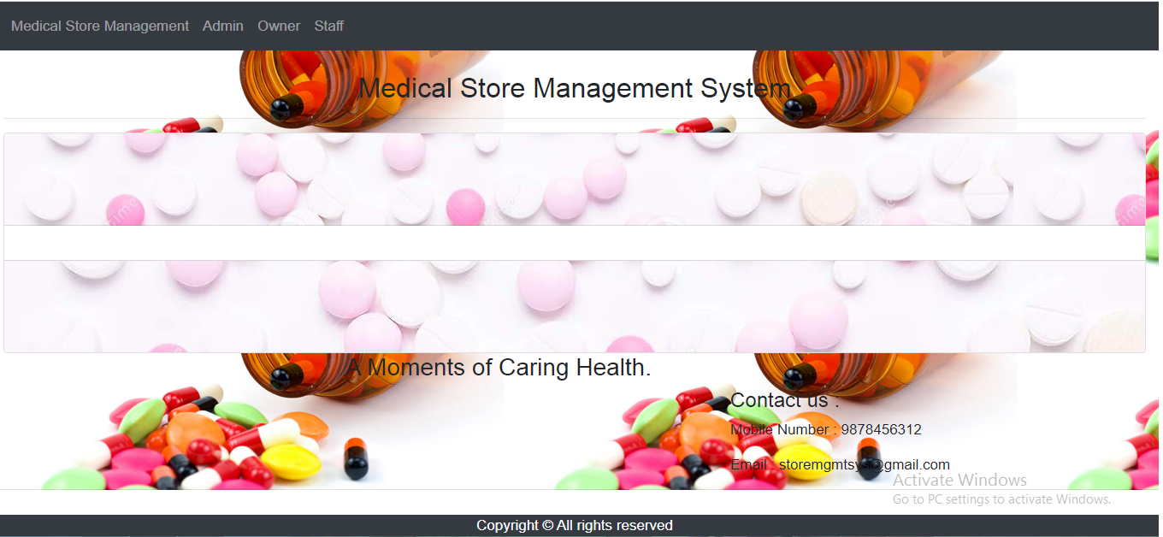
Index Page :
Representing three actors admin, owner, staff.

Slide 12
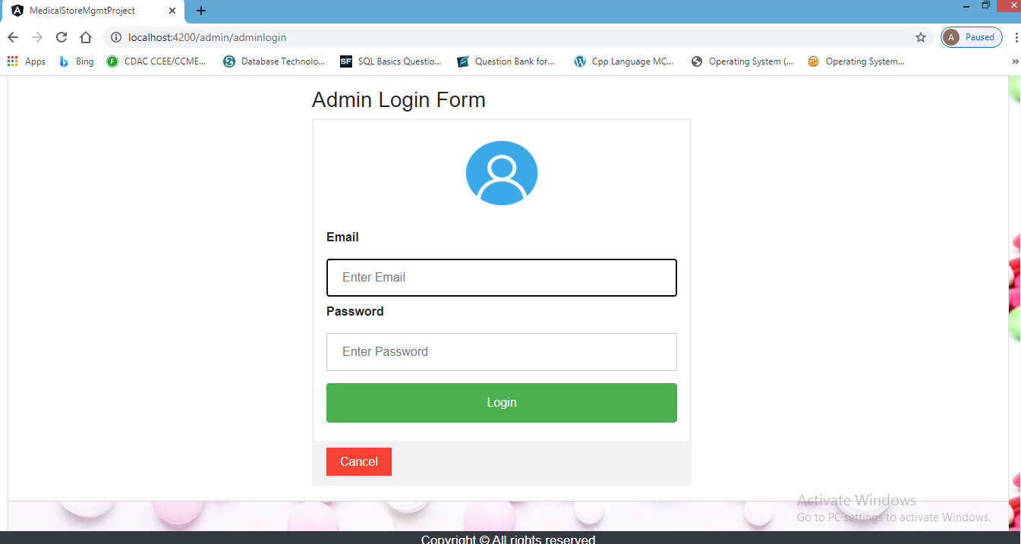
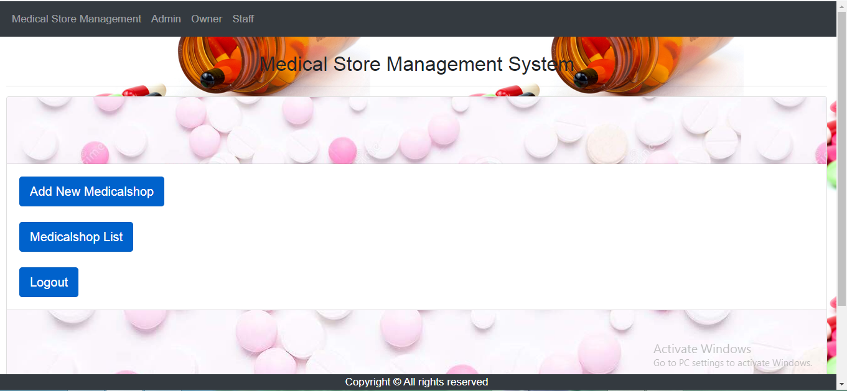
Admin View :-
The above snapshots show cases for the admin .
1.For login to admin the panel have email-id and password.
2. Admin have the rights to add the medical shop, can see shop list and their information.
3.Email:- Enter the desired email to access the login.
4.Password:- Enter the desired Password to access the login.

Slide 13
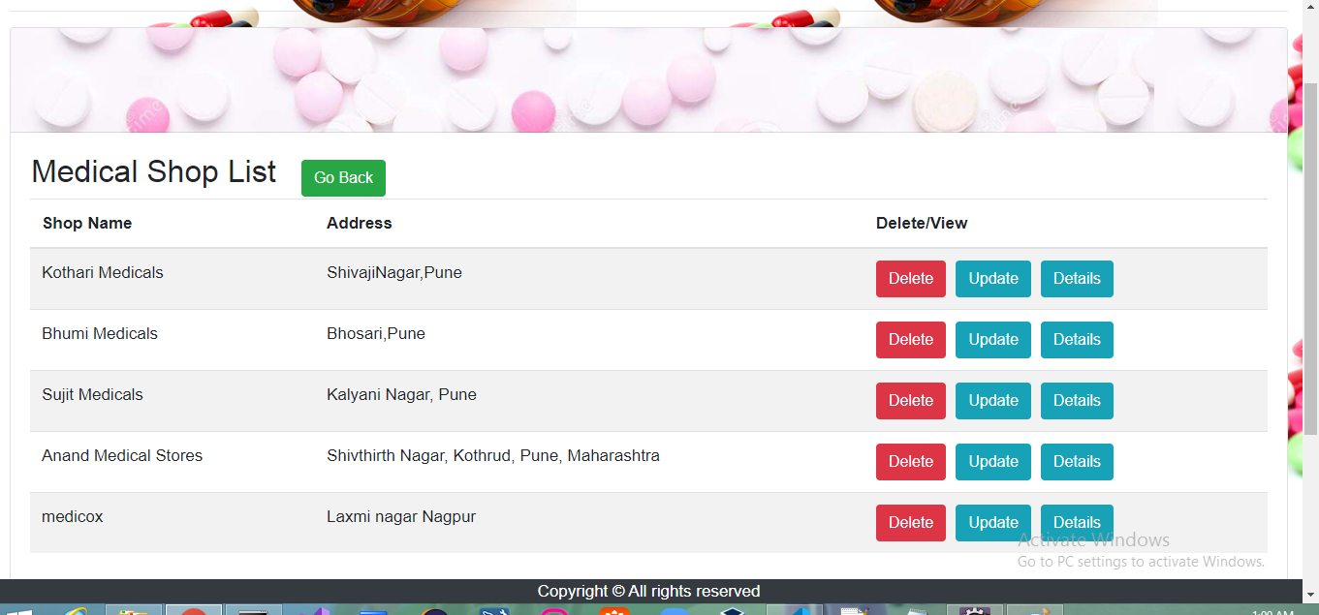
Here is the Entry list of Medical shop .We can Add, Delete and update the Medical shops details.

Slide 14
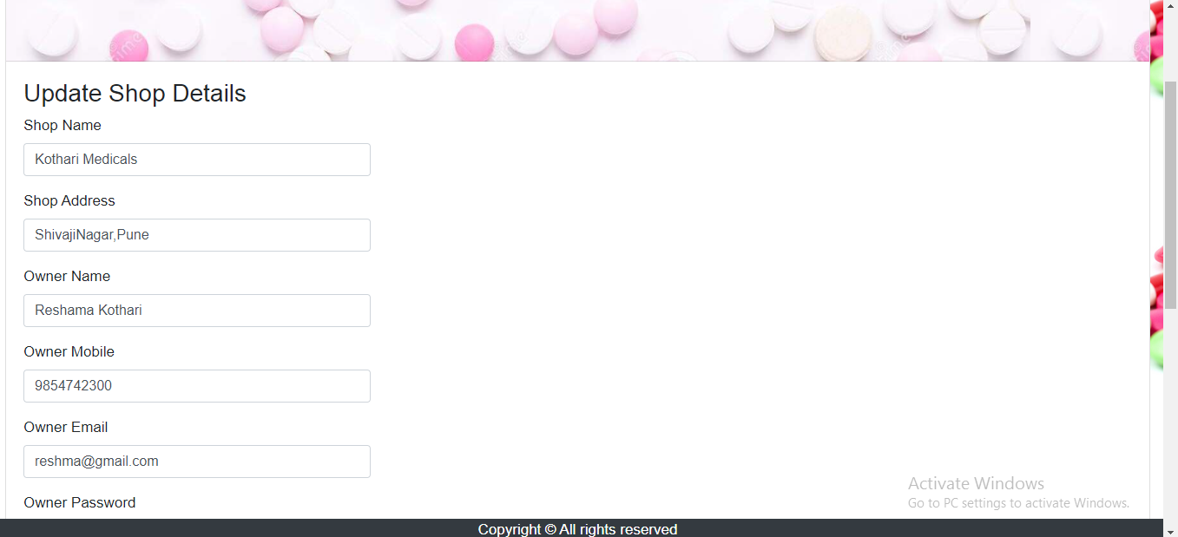
Update Shop Details:-
We can update the shop details as per requirement.

Slide 15
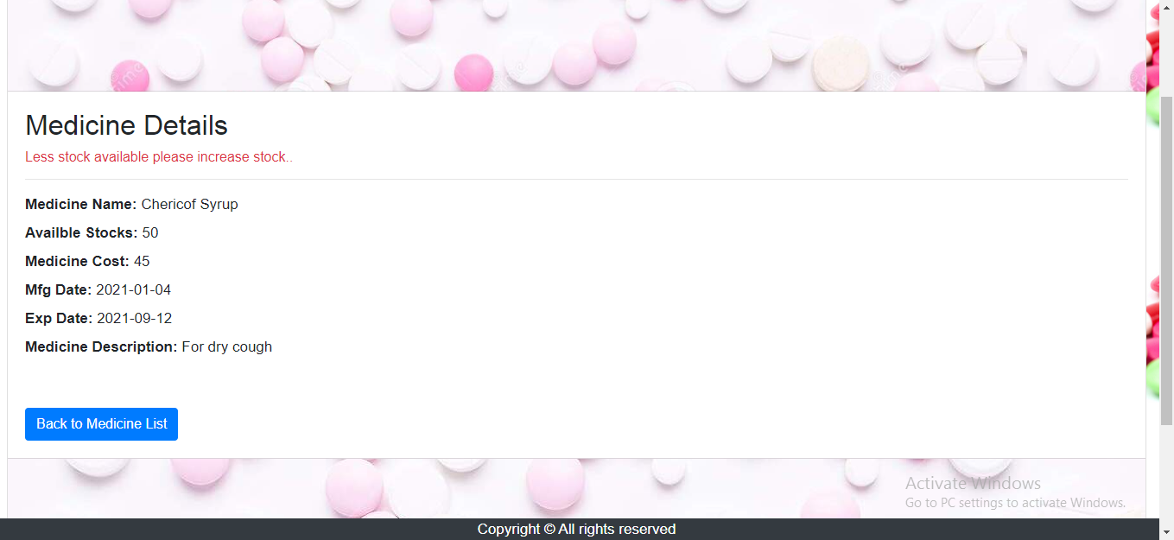
Alert Message :
Getting alert message form less stock.

Slide 16
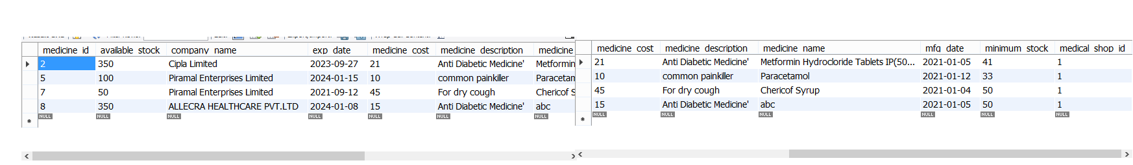
Tables :
Medicines table :

Slide 17
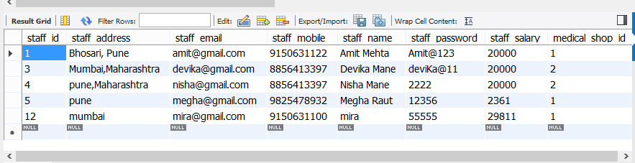
Staff Table:-

Slide 18
References
MR. M.N.Chavan 1, Ms. Ashwini Mane 2, Ms. Surabhi Kharate Assistant Professor, Department of Electronics And Telecommunication of Annasaheb Dange College of Engineering and Technology, Ashta, Maharashtra, India “Medicine Place Finder and Auto Inventory Management System In Medical Store” International Research Journal of Engineering and Technology (IRJET)
Mahatme MS, Dakhale GN, Hiware SK, Shinde AT, Salve AM Department of Pharmacology, Indira Gandhi Government Medical College, Nagpur, Maharashtra, India “Medical Store Management: An Integrated Economic Analysis of a Tertiary Care Hospital in Central India” JYP.
MS Mahatme, GN Dakhale, SK Hiware, AT Shinde, and AM Salve “Medical Store Management :An Integrated Economic Analysis of a Tertiary Care Hospital in Central India” J Young Pharm. 2012 Apr-Jun; 4(2): 114–118.

Slide 19
THANK YOU

